Slide 1
Chapter 2.3
Fiber loss and the measurement methods
Why it is necessary to investigate the fiber loss?
Fiber loss is a critical parameter of an optical fiber and determines how far a light can travel. Thus it can be also used to assess the performance of fiber communication system.
Fiber loss is related to the wavelength of the light in fiber, thus it determines different transmission windows in fiber communication systems.
As mentioned in the introduction, fiber loss had decreased from 20 dB/km in 1973 to 0.2 dB/km in 1993, and after that the loss level was further decreased.

Slide 2

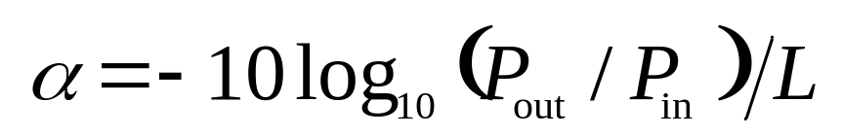
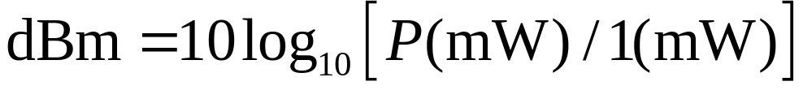
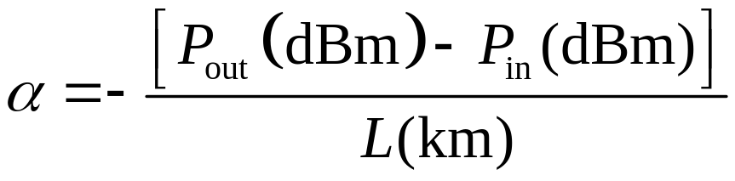
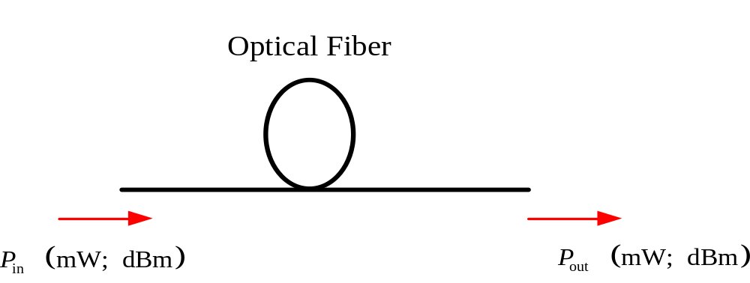
The definition of fiber loss
Definition of fiber loss：loss of light power in dB between input and output
Mathematical expression：
Unit of fiber loss：dB/km
For example：If the P_{in} is 100 mW , the P_{out} is 1mW, L=10 km, α=2 dB/km
The unit of light power in fiber communication system is usually scaled in dBm since it can be simply added.
Relationship between dBm and mW：
Another expression of loss
α=2 dB/km

Slide 3








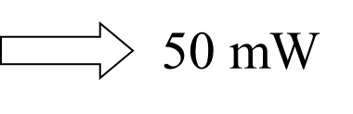

The definition of fiber loss [计算可能会用到]
+3 dBm对应功率乘以2 mW
-3 dBm对应功率除以2 mW
20dBm对应100mW
27dBm对应500mW
30dBm对应1000mW
Notes:
50mW是100的一半，因此20-3=17dBm

Slide 4
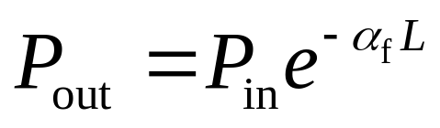
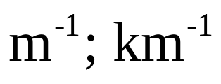
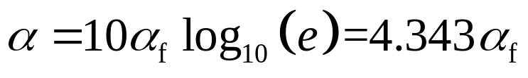
The attenuation coefficient
The attenuation coefficient α_{f}
Definition：
Unit：
The relationship between the attenuation coefficient α_{f} and the loss α :
4.343 dB/km ~ 1 km⁻¹; 21.715 dB/km~5 km⁻¹;
43.43 dB/km ~10 km⁻¹; 434.3 dB/km~100 km⁻¹

Slide 5
The causes of fiber loss：
① Material absorption and scattering within fiber ； 光纤内材料吸收和色散
② Fiber microbending and macrobending
光纤微弯和宏观折弯
③ Splice and coupling 折断和耦合

Slide 6
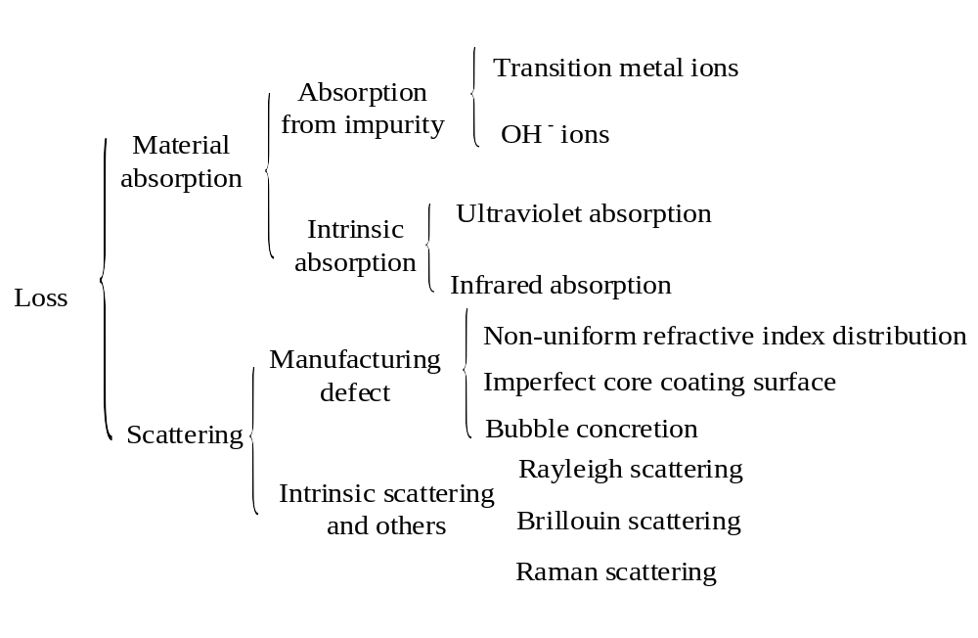
The causes of fiber loss：
(1) The causes of material absorption and scattering

Slide 7
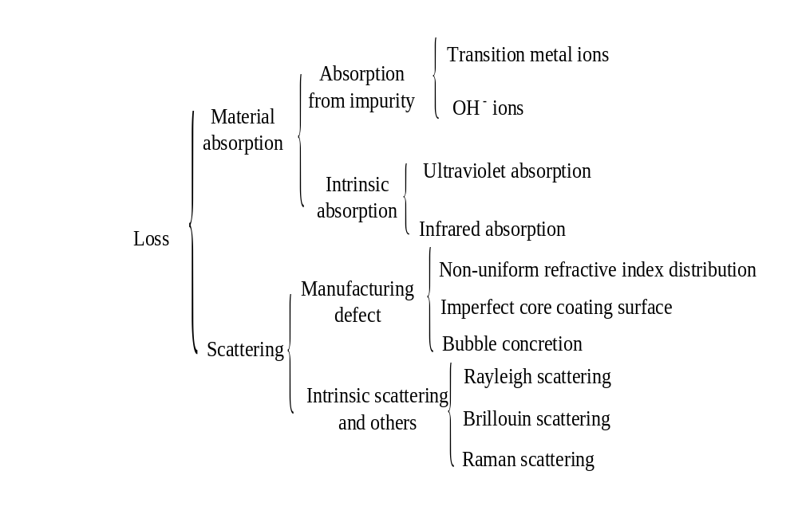
The causes of fiber loss：
(1) The causes of material absorption and scattering

Slide 8
Impurity absorption
Material absorption and scattering – 杂质吸收
Impurity absorption——mechanical harmonic absorption
Impure material and imperfect techniques lead to the introduction of transition metal ions (e.g., Fe, Mn, Ni, Cu, Co and Cr etc.) and OH⁻ ions
In order to make the loss at the center wavelength of impurity absorption band lower than 20 dB/km, the ratio of transition metal ions are required <10⁻⁹.
Three absorption peaks:1.39 μm, 1.24 μm and 0.95 μm
Three windows of fiber communication: 0.85 μm, 1.3 μm and 1.55 μm corresponding to the absorption valley of OH⁻ ions [来自氢氧焰]

Slide 9

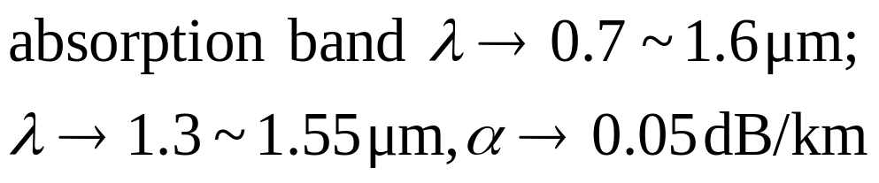
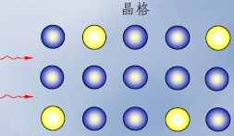
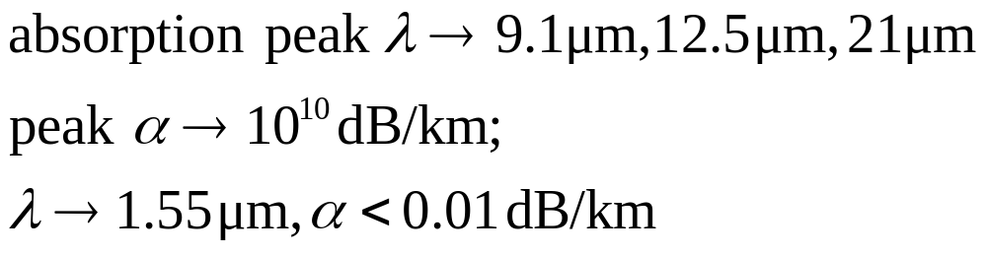
Intrinsic absorption
Material absorption and scattering – 本征吸收
Ultraviolet absorption：the electrons of fiber material absorbs the energy from ultraviolet and then excited to the higher levels, it results in the light energy loss and usually occurs at the short wavelength range
Infrared absorption：during the interaction of light wave with the crystal lattice, part of the energy was transferred to crystal lattice thus leading to a violent vibration, this also result in the loss.
crystal lattice

Slide 10
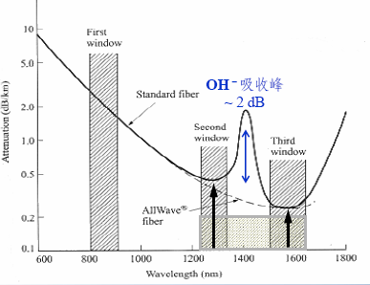
Material absorption and scattering – 本征吸收
Strategy：
To improve to the purity of the fiber material chemically e.g., 99.9999999%
(2)To improve the fiber fabrication technique, e.g., avoid oxyhydrogen flame heating
OH⁻ ions absorption peak

Slide 11
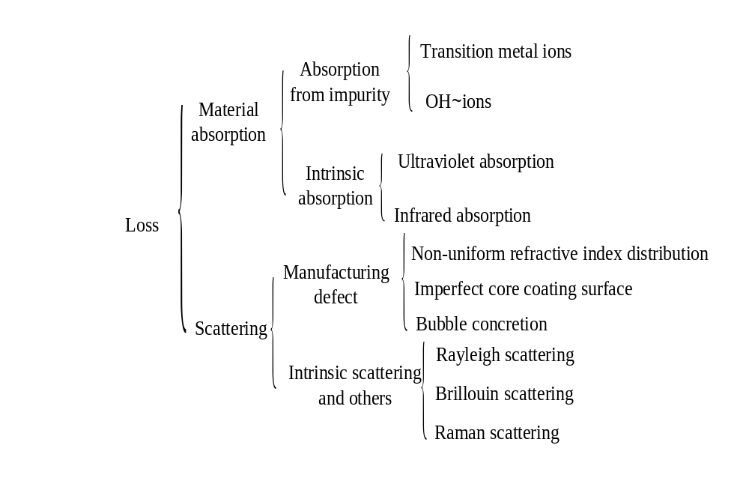
Material absorption and scattering – 散射
Main cause

Slide 12
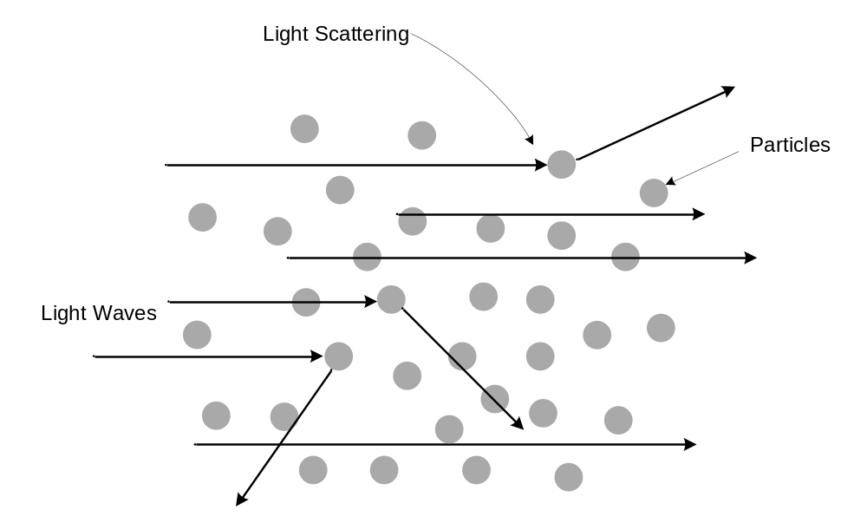
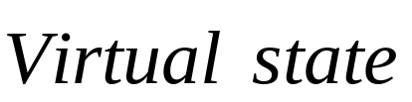
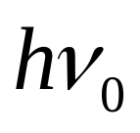

Rayleigh Scattering
Material absorption and scattering – 瑞利散射
Definition：It is a common optical phenomenon, named after the British physicist Lord Rayleigh. It is linear scattering of light at scattering centers which are much smaller than the wavelength of the light. The light isn’t absorbed, just sent in another direction. No new frequency components are generated. It isn’t related to light intensity in fiber.

Slide 13
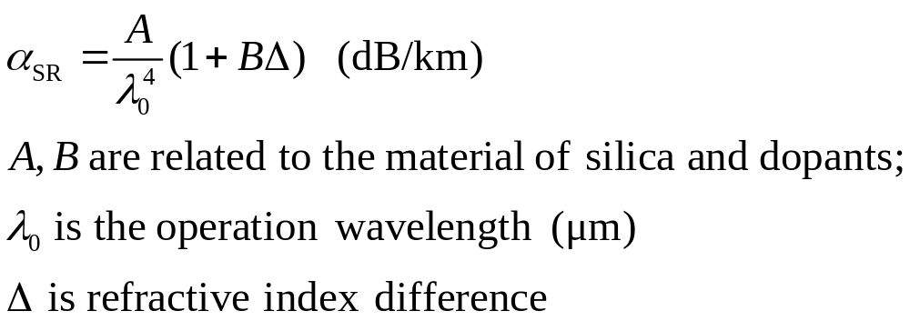
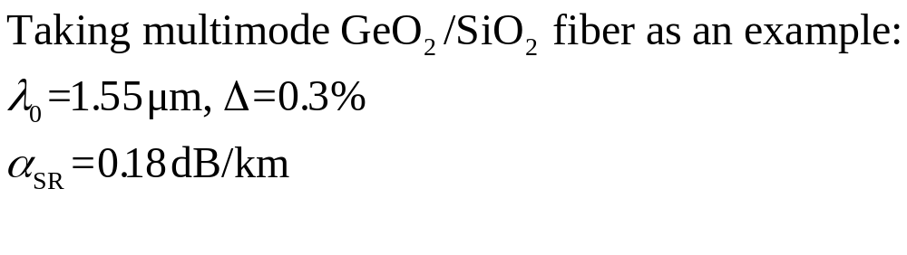
Material absorption and scattering – 瑞利散射系数
Fiber | Material | A | B
Multimode | GeO₂/SiO₂ | 0.8 | 100
Multimode | P₂O₅/SiO₂ | 0.8 | 42
Single mode | GeO₂/SiO₂ | 0.63 | 180±35
Note that the Rayleigh scattering currently cannot be removed, it determines the limitation of fiber loss.

Slide 14
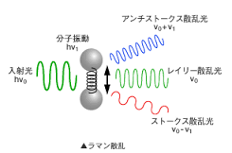
Raman scattering
Material absorption and scattering – 拉曼散射
Definition：It is caused by vibrations of the crystal (or glass) lattice associated with optical phonons. One photon is converted into one lower-energy or higher-energy signal photon, and the difference of photon energies is compensated by a phonon. The new frequency components are generated. Thus the energies of initial frequency components are lost partly. It is nonlinear scattering.
hv₀+hv_{m}
vibrations
hv₀
hv₀
hv₀-hv_{m}

Slide 15
Material absorption and scattering – 拉曼散射
At a low power level, Raman scattering effect can occur spontaneously called as Spontaneous Raman scattering[自发].
At a high power level, it can be changed to a stimulated effect called as Stimulated Raman scattering (SRS)[受激,带来的损耗大很多].
For example:
For the multimode fiber with a core diameter of 75 μm and a loss 4 dB/km at 1.06 μm, the threshold of stimulated Raman scattering (SBS) is 500 W
For the single mode fiber with a core diameter of 7.5 μm and a loss 0.4 dB/km at 1.06 um, the threshold of stimulated Raman scattering is decreased to 500 mW.
Typical communication source power is at the range of 1~10 mW
It indicates that the SRS can be neglected.[可以被忽略]

Slide 16
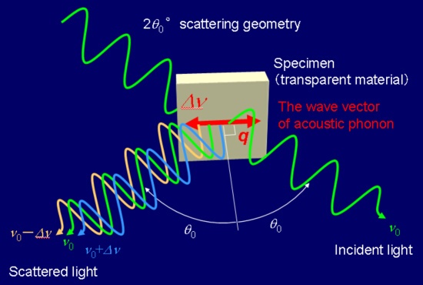
Brillouin scattering
Material absorption and scattering – 布里渊散射
Definition：For a optical medium, the thermal motion of atoms, molecules and ions will generate acoustic phonons. An incident photon can be converted into a scattered photon with slightly lower or higher energy and a compensated phonon. New frequency components are generated.
Main differences between Raman and Brillouin scatterings:
Raman scattering is related to optical phonons (typically large, high frequency), and Brillouin scattering is related to acoustic phonons (typically small, low frequency).
Raman scattering occurs in both forward and backward directions, Brillouin scattering occurs only in backward directions.
拉曼: 原子在晶胞内的振动
布里渊: 晶体整体的振动

Slide 17
Material absorption and scattering – 布里渊散射
At a low power level, Brillouin scattering effect can occur spontaneously called as Spontaneous Brillouin scattering.
At a high power level, it can be changed to a stimulated effect called as Stimulated Brillouin scattering (SBS).
For example:
Typical communication source power is at the range of 1~10 mW
For the multimode fiber with a core diameter of 75 μm and a loss 4 dB/km at 1.06 μm, the threshold of stimulated Brillouin scattering (SBS) is 2.5 W, thus the SBS can be neglected.
For the single mode fiber with a core diameter of 7.5 μm and a loss 0.4 dB/km at 1.06 μm, the threshold of stimulated Brillouin scattering is decreased to 2.5 mW,
Thus the SBS can not be neglected. [不能被忽略]

Slide 18
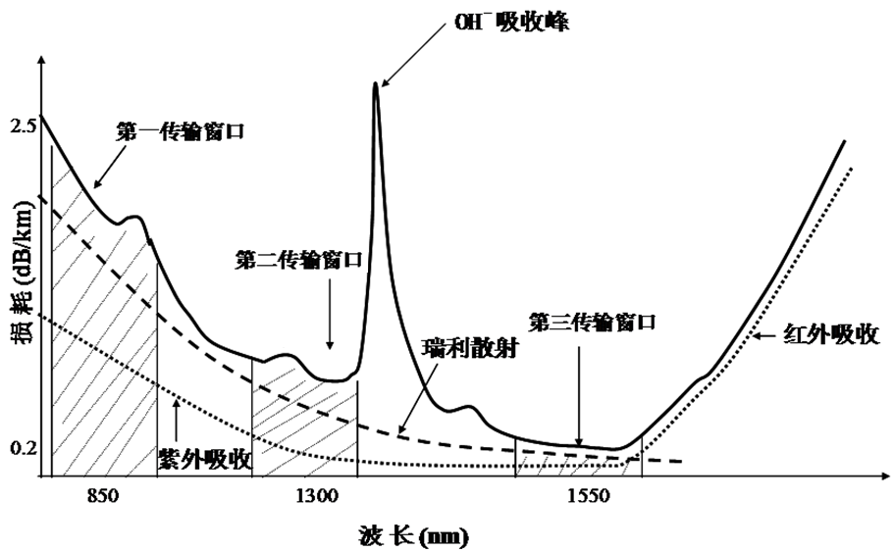
The loss spectrum of fiber
0.85 1.33 1.55
OH⁻ ions absorption peak
The absorption valley of OH⁻ ions corresponds to three transmission windows and the limited loss is determined by the Rayleigh scattering.
The first transmission window
The second transmission window
Loss (dB/km)
The third transmission window
Rayleigh scattering
Infrared absorption
Ultraviolet absorption
Wavelength (nm)

Slide 19
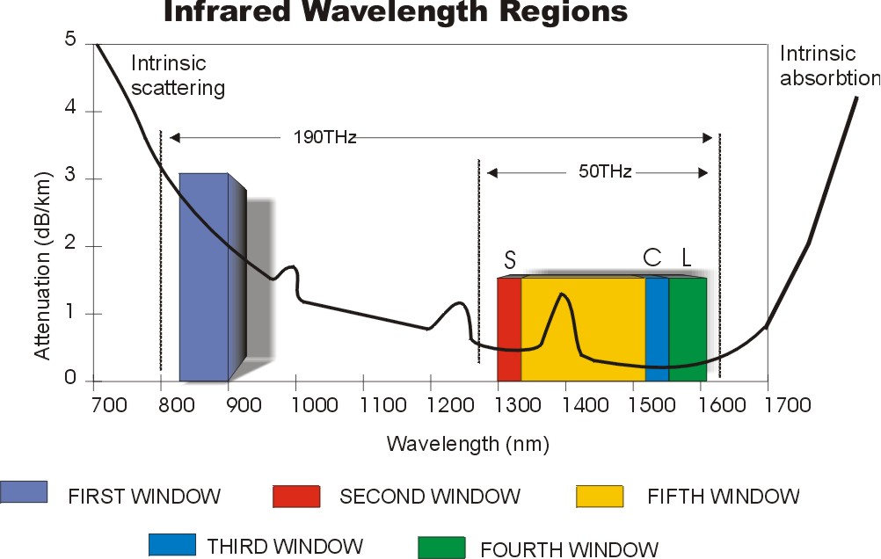
In 1998，Lucent Corporation of America fabricated the all wave fiber which remove the absorption peak at 1385 nm and broadened the low loss band from 1250 nm to 1650 nm.

Slide 20
Transmission window：from 0.85 mm, 1.31mm,1.55 mm to S-band(1.49 mm~1.53 mm), C-band(1.53 mm~1.57 mm), L-band (1.57 mm~1.61 mm).
Available wavelength range
O-band (Original): 1260-1360 nm
E-band (Extended): 1360-1460 nm
S-band (Short):, 1460-1530 nm
C-band (Conventional): 1530-1565 nm
L-band (Long): 1565-1625 nm
U-band (Ultralong): 1625-1675 nm

Slide 21
(2) Fiber bending loss
Macrobending loss
Bending loss
Transition bending loss
Microbending loss

Slide 22
(2) Fiber bending loss
Physical mechanism
The total internal reflection in fiber was broken
Fiber bending
Waveguide mode transformed to leaky mode and even radiation mode
Bending loss
Guided mode
Radiation mode
Cladding
q
q¢
<
Core
q
q
q
q¢
q
q
>
c
R

Slide 23
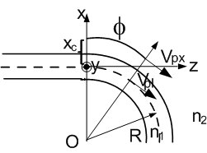
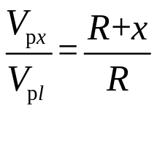
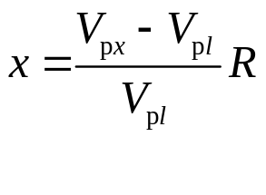
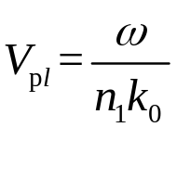
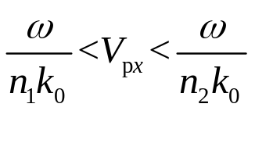
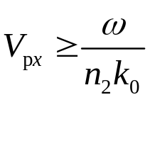
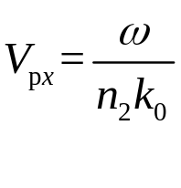
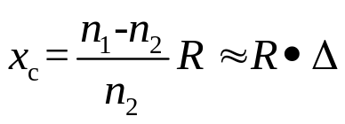
(2) Fiber bending loss
To determine the limitation of guided modes in bended fiber
The parallel equiphase surfaces intersect at O point due to the bending of the fiber. In order to keep the points at a equiphase surface have the same phase, the phase velocity should satisfy
B
B1
A
A1
In fiber core, guided modes:
In fiber cladding, guided modes :
When
The guided modes transformed to leaky modes
In limited case:
defines the limitation.
R↓→x_{c}↓→loss↑
The bending loss is also relative to the order of guided mode. The higher the order is, the larger the bending loss is.

Slide 24
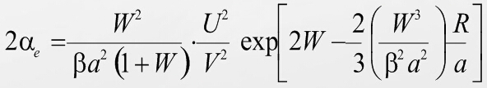


(2) Fiber bending loss
1) Macrobending loss [宏观弯曲]
The causes: coiling and buckling in practical applications
R is the bending radius
a is the fiber core radius
W is the normalized propagation constant
is the attenuation coefficient
It can be observed
Smaller R/a leads to larger α_{e}
Decreasing W can increase α_{e}

Slide 25
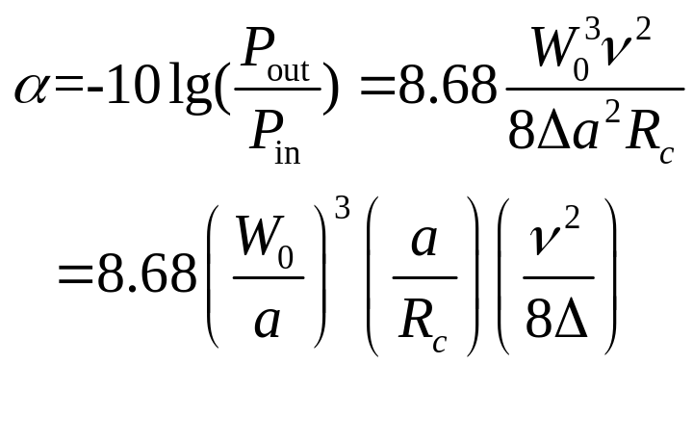
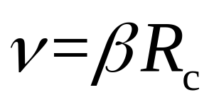
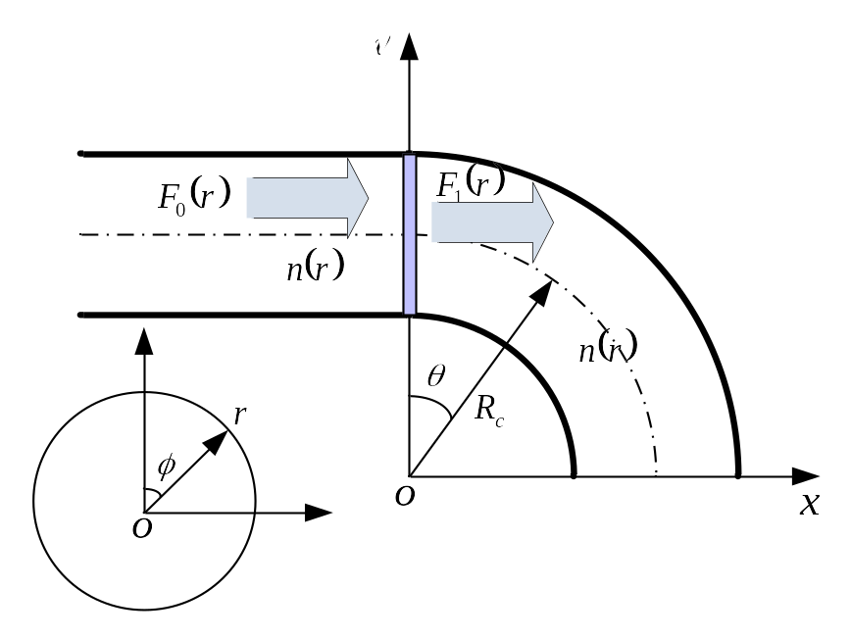
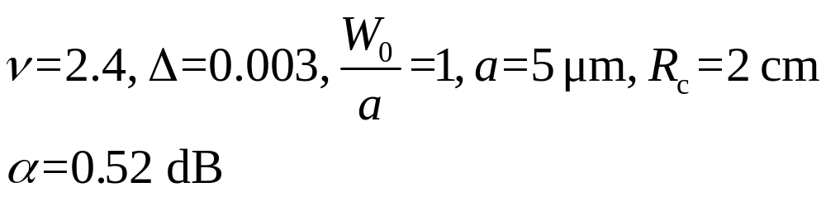
(2) Fiber bending loss
2) Transition bending loss
The cause: the sudden change from straight part to bended part or inconsistent bending of each section
W₀ is the mode field radius
a is the core radius
Taking the standard single mode fiber as an example:

Slide 26
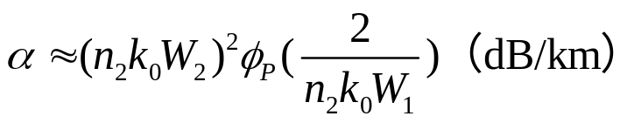
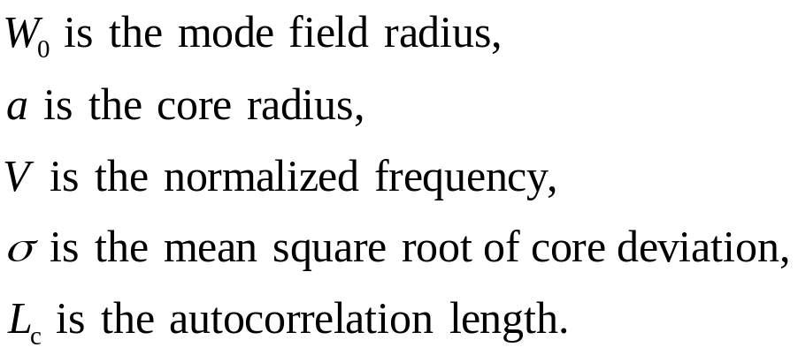
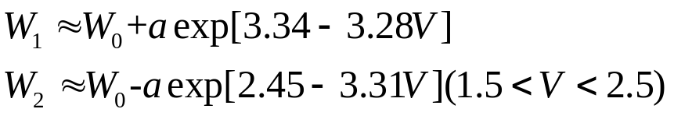
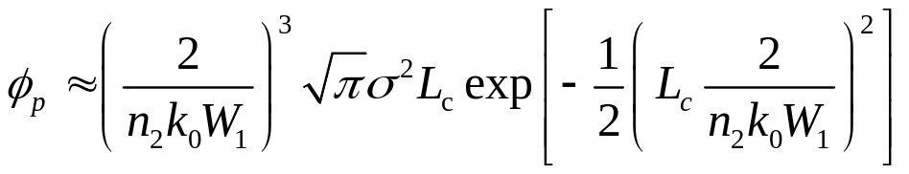
3) Microbending loss
The causes:
Nonuniformity from imperfect fiber fabrication
Nonuniform stress from optical cable fabrication
Different zones of a same fiber will experience different heat expansions and cold contractions in practical applications
The energies of low order modes are coupled to high order modes
The energies of high order modes escape from the fiber

Slide 27
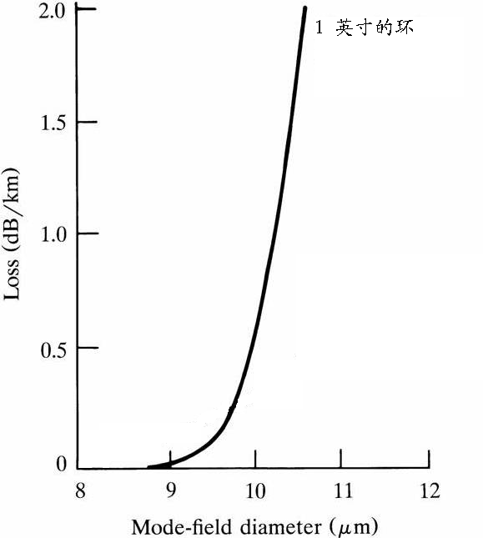
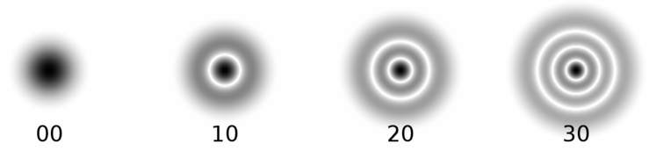
3) Microbending loss
The relationship between bending loss and mode field diameter
P_{cladding1}< P_{cladding2}
Loss _{small mode field diameter}<Loss _{large mode field diameter}
Loss _{low order mode}< Loss _{high order mode}
For an 1 inch fiber ring, the measured bending loss as a function of the mode field diameter

Slide 28
(3) Splice and coupling losses
Splice and coupling losses are caused by several factors. The major ones are listed as follows:
Overlap of fiber cores
Alignment of fiber axes
Fiber numerical aperture
Fiber spacing

Slide 29
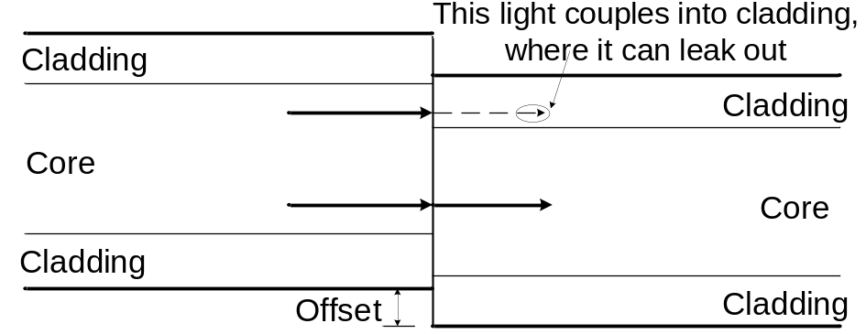
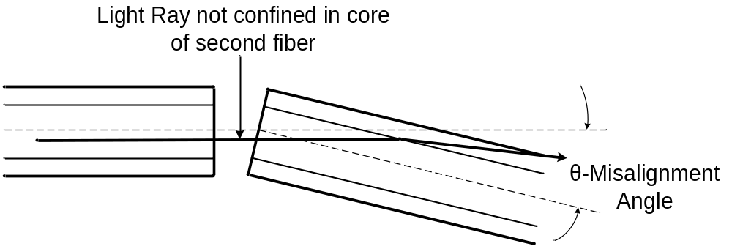
(3) Splice and coupling losses
Overlap of fiber cores
The end of one fiber is offset from the end of the other. The loss equals the fractional of the input-fiber core area that dose not overlap with that of the output fiber.
Alignment of fiber axes
As the angle θ between fibers increase, light from the first fiber enters the second fiber at a larger angle to the axis
A good connection should align the two fibers very closely

Slide 30
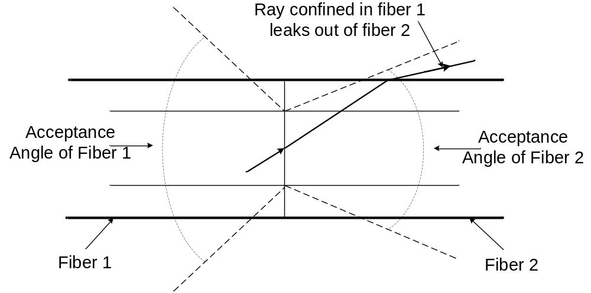
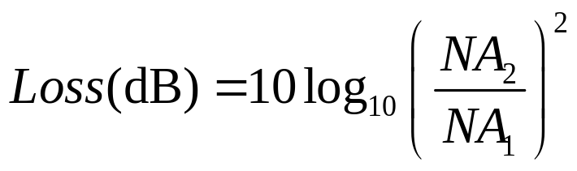
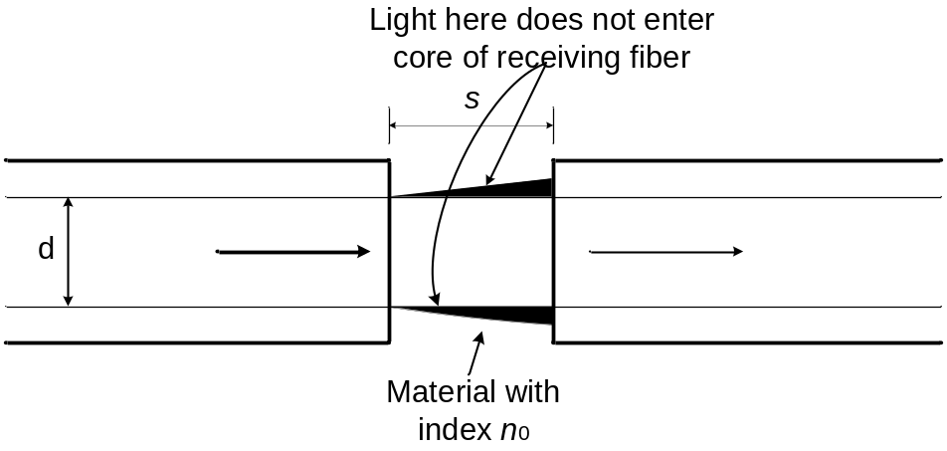
(3) Splice and coupling losses
Fiber numerical aperture
If the fiber receiving the light has a smaller NA than the one delivering the light, some light will enter it in modes that are not confined in the core. Then light will quickly leak out of the fiber.
Fiber spacing
Two different mechanisms can cause loss if there is a gap between fibers:
1) Spreading of light emerging from the input fiber
2) Reflection of light passing between air and glass

Slide 31
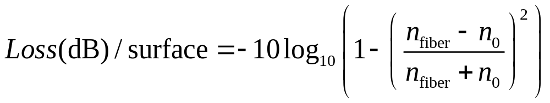
(3) Splice and coupling losses
Reflection of light passing between air and glass belongs to Fresnel reflection, which occurs whenever light passes between two materials with different refractive indexes.
For the light going between glass and air, the loss is about 0.15 dB if the glass has a refractive index of 1.45 and 0.18 dB if the refractive index is 1.5.

Slide 32
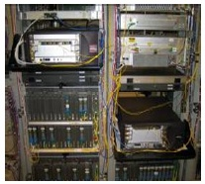

The compensation of loss [补偿损耗]
Electrical signal amplifying
Optical signal → Electrical signal → Optical signal
Optical amplification
EDFA
Raman amplifier

Slide 33


The measurement of fiber loss [损耗测量]
Loss spectrum
Cutback method [截断法]
(Destructive measurement)
(2) Insertion loss method [插入损耗法]
(Non-destructive measurement)
(3) Back scattering method [后向散射法]
(Non-destructive measurement)

Slide 34

The measurement of fiber loss [损耗测量]
(1) Cutback method
First step:
Using a fixed light source with fixed output power. Coupling the light into the test fiber, and then measuring the output power P₁ at the fiber end
Total length L₁
Light source
P₁
Second step:
Cutting the fiber at a fixed length, and then measuring the output power P₂ at the fiber end
Residual length L₂
Light source
P₂
Note that P₁ and P₂ must be measured at the same initial power. Though cutback method is destructive for fiber, it has a significantly high precision [高精度], the error can be below 0.1 dB.

Slide 35

The measurement of fiber loss [损耗测量]
(2) Insertion loss method
First step:
Using a light source with fixed output power. Coupling the light into a short fiber with length of L₁ same as the test fiber, measuring the output power P₁ at the fiber end.
Length L₁
Light source
P₁
Second step:
Connecting the test fiber via a mobilizable connector, measuring the output power P₂ at the fiber end.
x is the insertion loss of the connector
Length L₁
The fiber to be measured
Light source
P₂
Connector
Length L₂
It is convenient to use a mobilizable connector to connect two fibers. But it should be noted that the loss (0.2~0.5 dB) introduced by the connector should be removed in calculation. Though the method is non-destructive, it has a low precision [精度较低].

Slide 36

The measurement of fiber loss [损耗测量]
(3) Back scattering method
Comparison：Compared to previous methods which can be only used to measure the fiber average loss, back scattering method can give the detailed loss information along fiber.
Advantages：1) the loss at any positions of the fiber can be measured；2) the position can be determined.
Mechanism：The loss at one point is obtained by measuring the scattering signal.
Steps: Injecting pulsed signal into the test fiber, setting the power at input end (z=0) as P_{i} , when the light signal reaches the point with a distance z from the input end , the power attenuates to
If setting the reflection coefficient as R(z), the signal that is reflected at the position z to the input end can be expressed as

Slide 37








The measurement of fiber loss [损耗测量]
(3) Back scattering method
If defining the average loss as：
Setting R(z) as a constant, we can obtain：
The position z can be determined by
△t is the time delay between input pulse and echo pulse
The method of measuring return loss can be used to fabricate Optical Time Domain Reflectometer （OTDR）！

Slide 38

Optical Time Domain Reflectometer （OTDR）
The measurement of fiber loss [损耗测量]
The functions of OTDR
Measuring fiber total loss
•Measuring fiber loss per unit
•Measuring splice loss of fiber
•Measuring return loss of fiber connector
•Measuring fiber length
•Measuring fiber macrobending and microbending
•Finding the positions of defect and breakpoint of fiber

Slide 39


Slide 40


